Slide 1
How to Plan your calendar
Implementing NHD in Your Classroom

Slide 2
NHD Process
Introduction to NHD Process/Annual Theme
Research
Thesis Statement & Final Research
Topic Exploration/Selection
Project Organization & Outline
Project Creation & Paper Work

Slide 3

How to Create Your NHD Timeline
Step 1: Work backwards. Start with the date of your regional contest deadlines and count back to determine how many weeks you have.

Slide 4
Step 2: Divide your time into manageable pieces.
 | 6 Weeks | 10 Weeks | 15 Weeks
Intro to NHD Process and Annual Theme | 1 Week | 1 Week | 1 Week
Topic Exploration and Selection |  | 1 Week | 2 Weeks
Research | 2 Weeks | 4 Weeks | 5 Weeks
Thesis Statement and Final Research | 1 Week | 1 Week | 2 Weeks
Project Organization and Outline | 1 Week | 1 Week | 2 Weeks
Project Creation, Process Paper, Bibliography | 1 Week | 2 Weeks | 3 Weeks

Slide 5
Step 3: Create a calendar for each week
Dates | Work
Dec 10-14 | Intro to NHD Process and Annual Theme
Dec 17-21 | Topic Exploration and Selection
Jan 8-Feb 2 | Research
Feb 5-9 | Thesis Statement and Final Research
Feb 12-16 | Project Organization and Outline
Feb 19-March 2 | Project Creation, Process Paper, Bibliography
March 2 | Entry Deadline

Slide 6

Beware!
Entry types have different deadlines.
Snow days!
You do not want to be rushed at the end.
School assemblies, field trips, etc.

Slide 7
Step 4: Add important deadlines and graded milestone assignments.
Product Due | Due Date | Point Value
Topic Proposal
Contract
Research Plan
Sources Check-Ins
Thesis Statement
Process Paper
Bibliography
Final Project

Slide 8
Dec 10-14 | Intro to NHD/Theme | Product Due | Due Date | Point Value (200 Pts Available)
Dec 17-21 | Topic Exploration/Selection | Topic Proposal | Dec 21 | 10
 |  | Contract | Dec 17 | 10
Jan 8-Feb 2 | Research | Research Plan | Jan 8 | 10
 |  | Sources Check-Ins | Jan 16, Jan 29 | 30
Feb 5-9 | Thesis Statements/Final Research | Thesis Statement | Feb 9 | 10
Feb 12-16 | Project Creation/Paperwork | Project Outline | Feb 16 | 10
Feb 19-March 2 |  | Process Paper | Feb 20 | 10
 |  | Annotated Biblio | Feb 25 | 10
 |  | Final Project | March 2 | 100

Slide 9
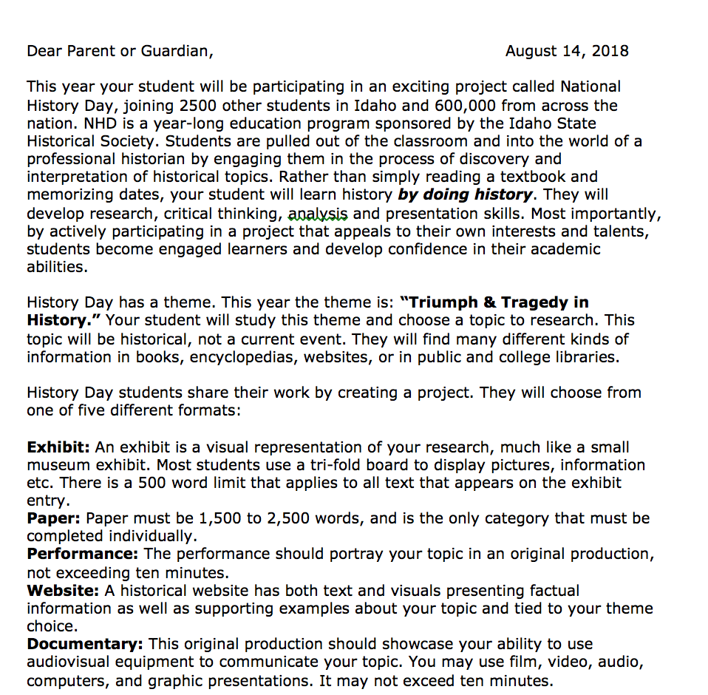
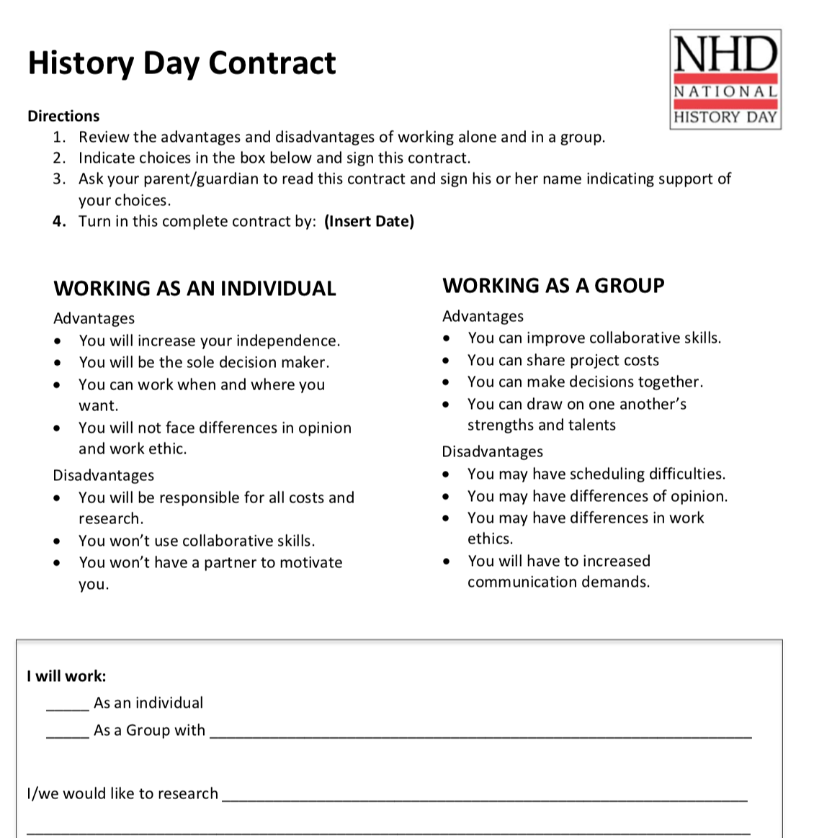
Step 5: Share with administrators, students, and parents

Slide 10
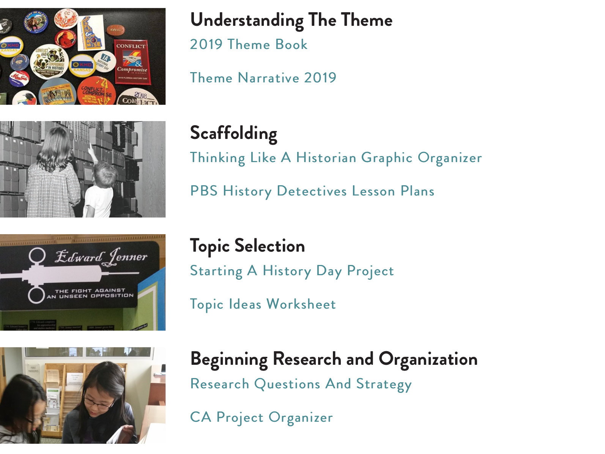
Teacher Toolkit Resources
https://history.idaho.gov/nhdi

Slide 11
Let’s get to work! Plan Away!

